Slide 1
SOLE TRADERS AND COVID-19
Andy Chamberlain
Director of Policy
Inna Yordanova
Senior Researcher
Alasdair Hutchison
Policy Development Manager

Slide 2
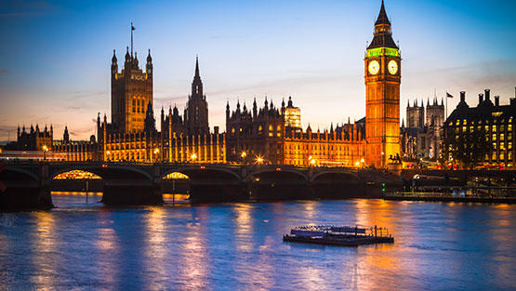
Coronavirus – Support for sole traders
What has the economic impact of coronavirus been on the self-employed?
What support has the government announced? What is IPSE doing to represent members and the self-employed?
Where can I find more information?

Slide 3
Background: IPSE and the SEISS
IPSE wrote to government ministers in February highlighting fears about the impact of Covid-19 and the lack of support
Policy team has given evidence to several parliamentary committees
Lobbied government for income protection fund and consulted with Treasury on the ‘Self-Employment Income Support Scheme’ (SEISS)
SEISS announced on March 26
Engaged in ongoing discussions around suggestions for how to improve self-employment support schemes

Slide 4
IPSE’s research on the coronavirus outbreak
What the research examined
freelancers’ attitudes towards the crisis
the impact it is having on them, their self-employed businesses and their income
their attitudes towards the government measures provided, before and after the Chancellor’s announcement on 26th March
Notes:
- Background – media, gov, member queries – impact on SE and support needed
The analysis is based on the responses of an online survey which was open from 19th March until 1st April 2020. The survey was completed by 941 freelancers who are IPSE and PeoplePerHour members, 37 per cent of whom were female and 62 per cent male, with an average age of 45 and average daily rate of £415. Proportion of limited companies (60%) vs sole traders (38%).
Present the SEISS here – a taxable grant for the self-employed worth 80 per cent of their average monthly profits over the last three years up to £2500 a month
Limited companies, earn over 50k a year, generate more than half of their income from somewhere else rather than SE, new to self-employment

Slide 5
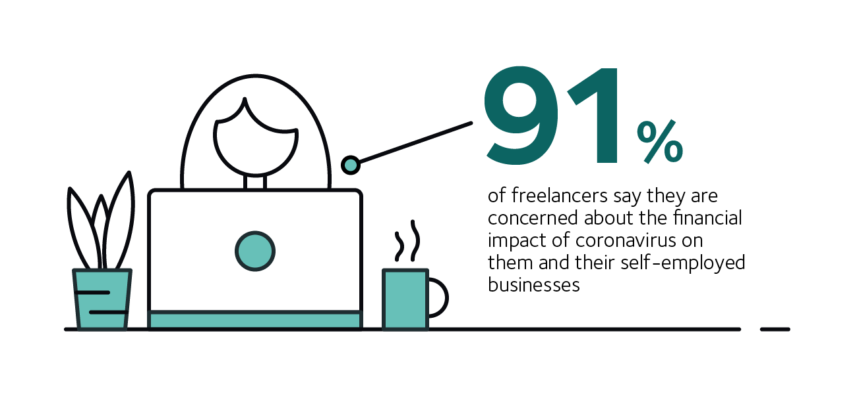
Levels of concern among the self-employed
Notes:
No difference between age, gender, occupation and legal form

Slide 6
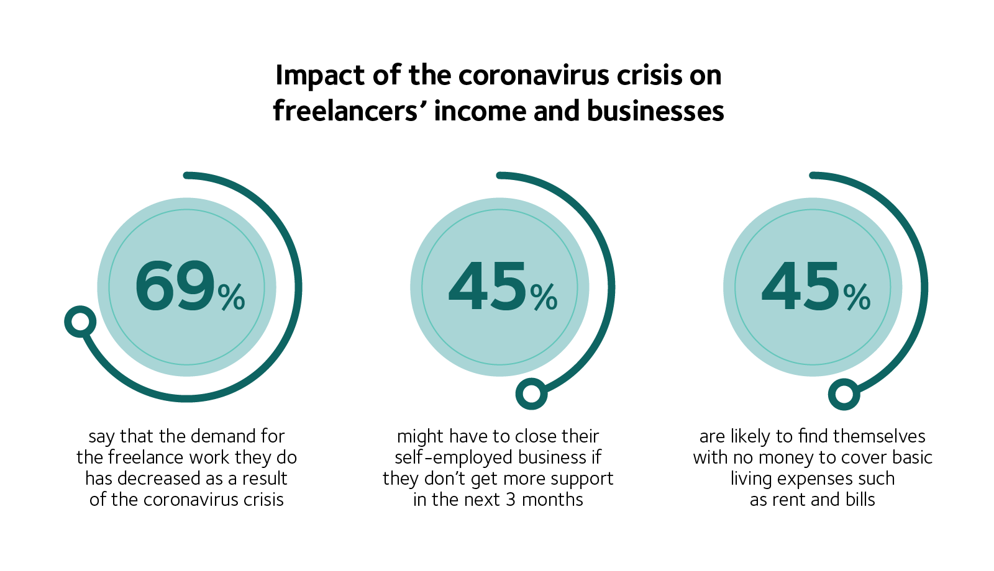
Notes:
This explains the high levels of concern – amount of work they do, stability of their businesses, their incomes and personal circumstances
While the coronavirus outbreak seems to be affecting all freelancers, the data shows that it is affecting sole traders and limited companies differently.
A greater proportion of sole traders (74%) are experiencing declining demand for work in comparison with limited companies (66%).
Limited companies (48%), on the other hand, are more likely than sole traders (39%) to expect to have to close their self-employed business as a result of the outbreak if they don’t receive any support in the next 3 months.
Sole traders (55%) are much more likely to expect to end up with no money to cover basic living expenses such as bills and rent in comparison with limited companies (39%).

Slide 7
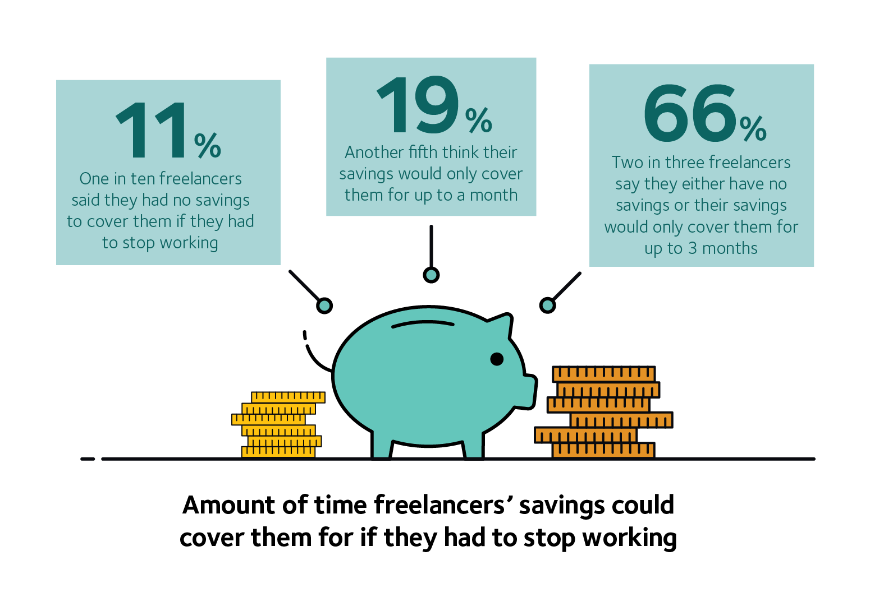
Notes:
How freelancers are going to manage to financially adapt to the slowing demand for work, increasingly depends on the amount of savings they have.
The findings are perhaps concerning because those who are eligible for the SEISS grant will have to wait until June to receive the money.
On average, freelancers think that their savings could cover them for 21 weeks if they had to stop working, but the number is much lower for sole traders (13 weeks) in comparison with limited companies (27 weeks).

Slide 8
Notes:
When we asked freelancers about other ways the outbreak is likely to affect them else than losing their savings, a significant proportion said they think they are at risk of experiencing contract delays or cancellations (74%), using all or most of their savings (68%) and losing clients (60%).
Two in five also think they will have to register for income support (38%) or withdraw money from their businesses (40%). One in seven (14%) expect having to face withdrawal penalties to access their longer-term savings such as pensions or LISAs early.
-----
Sole traders are much more likely to have to register for income support (48% compared to 34% for limited companies).
Limited companies (54%), on the other hand, are more likely to have to withdraw money from their businesses in comparison with sole traders (19%).

Slide 9
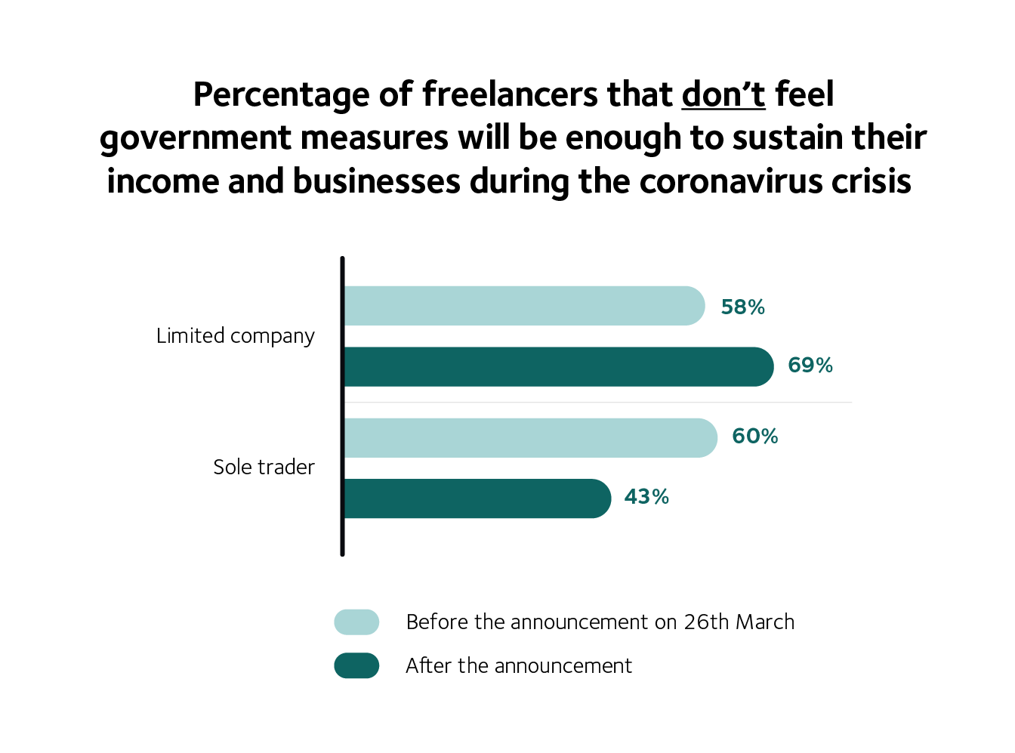
Attitudes towards government support measures
Looking at the full survey period, three in five (60%) freelancers didn’t think that the government support schemes announced would be enough to sustain their income and their business during the outbreak.

Slide 10
The Government’s Self-Employment Income Support (SEISS) scheme - eligibility
Must have a tax return filed for 2018/19 and still be operating – if you have filed in 16/17 and 17/18 HMRC will also use these to calculate your grant
You must have yearly trading profits which average no more than £50,000 over those years
More than half of your income must be from self-employment across this period
Those eligible can still operate and claim the grant

Slide 11
How will the SEIS work?
You will be written to by HMRC in mid-May if you are eligible, you will then have to fill out an online form
HMRC will use a risk based approach to compliance to confirm your business has been affected by COVID-19
Grant will cover March 1st to end of May (this could be extended)
You will be sent a lump sum by early June
This grant will cover 80% of your average income, capped at £2,500 per month (maximum grant £7,500)

Slide 12
Who misses out?
Applies to sole traders and members of a partnership – not limited company directors (dividend income not considered)
Scheme doesn’t cover newly self employed, and penalises those who became self-employed in the closing months of the 2018/19 tax year. IPSE believes it would be possible to allow them to file promptly for the tax year 19/20
Nothing for those with profits of over £50,000. IPSE have suggested a taper to avoid a sharp cliff edge which punishes profitable businesses
Those who took a break from self-employment (maternity, employment etc) won’t have these periods considered in the calculation.

Slide 13
Other support available – business and tax
Newly Self-Employed Hardship Fund (Scotland-only)
Grants of £2,000 via local authorities – applications open end April, funds out by early May
Bounce Back Loans
Maximum of £50,000, or 25% of turnover, with the government paying the interest for the first 12 months
Government is guaranteeing 100% of the loan
Coronavirus Business Interruption Loan Scheme
Government backed loans up to £5m, no fees first 12 months
Sole traders are eligible - as long as business activity is operated through a business account
Personal guarantees of any form will not be taken for loans below £250k

Slide 14
Other support available – business and tax
Help with taxes
Self-Assessment tax return payment due on 31 July can be deferred until January 2021
VAT payments due between 20 March 2020 and 30 June 2020 can be automatically deferred
HMRC Time to Pay arrangements - a helpline for businesses and self-employed people who are concerned about paying their tax due to COVID-19 (0800 024 1222)
Other support
Grant funding - provided by local authorities, industry-based hardship funds and devolved administrations – links on IPSE coronavirus hub
Banks and building societies – access to finance and lending, loans, credit cards, overdrafts
Mortgages and rent – payment holidays, rent payment schemes

Slide 15
Other support available – welfare system
Universal Credit
Eligibility: low income or out of work, over 18, under State Pension age
Savings/capital: over £16k you are ineligible; £6-16k will be factored in
How much can I get? https://www.entitledto.co.uk/
Standard allowance has increased – e.g. single claimant (25 or over) risen from £317.82 to £409.89 per month – and may be higher depending on circumstances
You can claim UC while waiting for SEISS – it won’t affect your grant
Other support
Employment & Support Allowance - payable from first day of sickness, £73.10/week (over 25)

Slide 16
How can I stay up to date?
Sign up to IPSE’s newsletter: http://ipse.in/IPSE-news
Check out IPSE’s website https://www.ipse.co.uk/ and our FAQ page: https://www.ipse.co.uk/coronavirus-hub/coronavirus-self-employed-faqs.html
Information on IPSE membership: https://www.ipse.co.uk/become-a-member.html
Send your case studies to covid@ipse.co.uk
IPSE Coronavirus Report: https://www.ipse.co.uk/coronavirus-hub/coronavirus-report.html
Twitter https://twitter.com/teamIPSE
Facebook https://www.facebook.com/teamIPSE/
LinkedIn https://www.linkedin.com/company/the-association-of-independent-professionals-and-the-self-employed-ipse/

